Slide 1
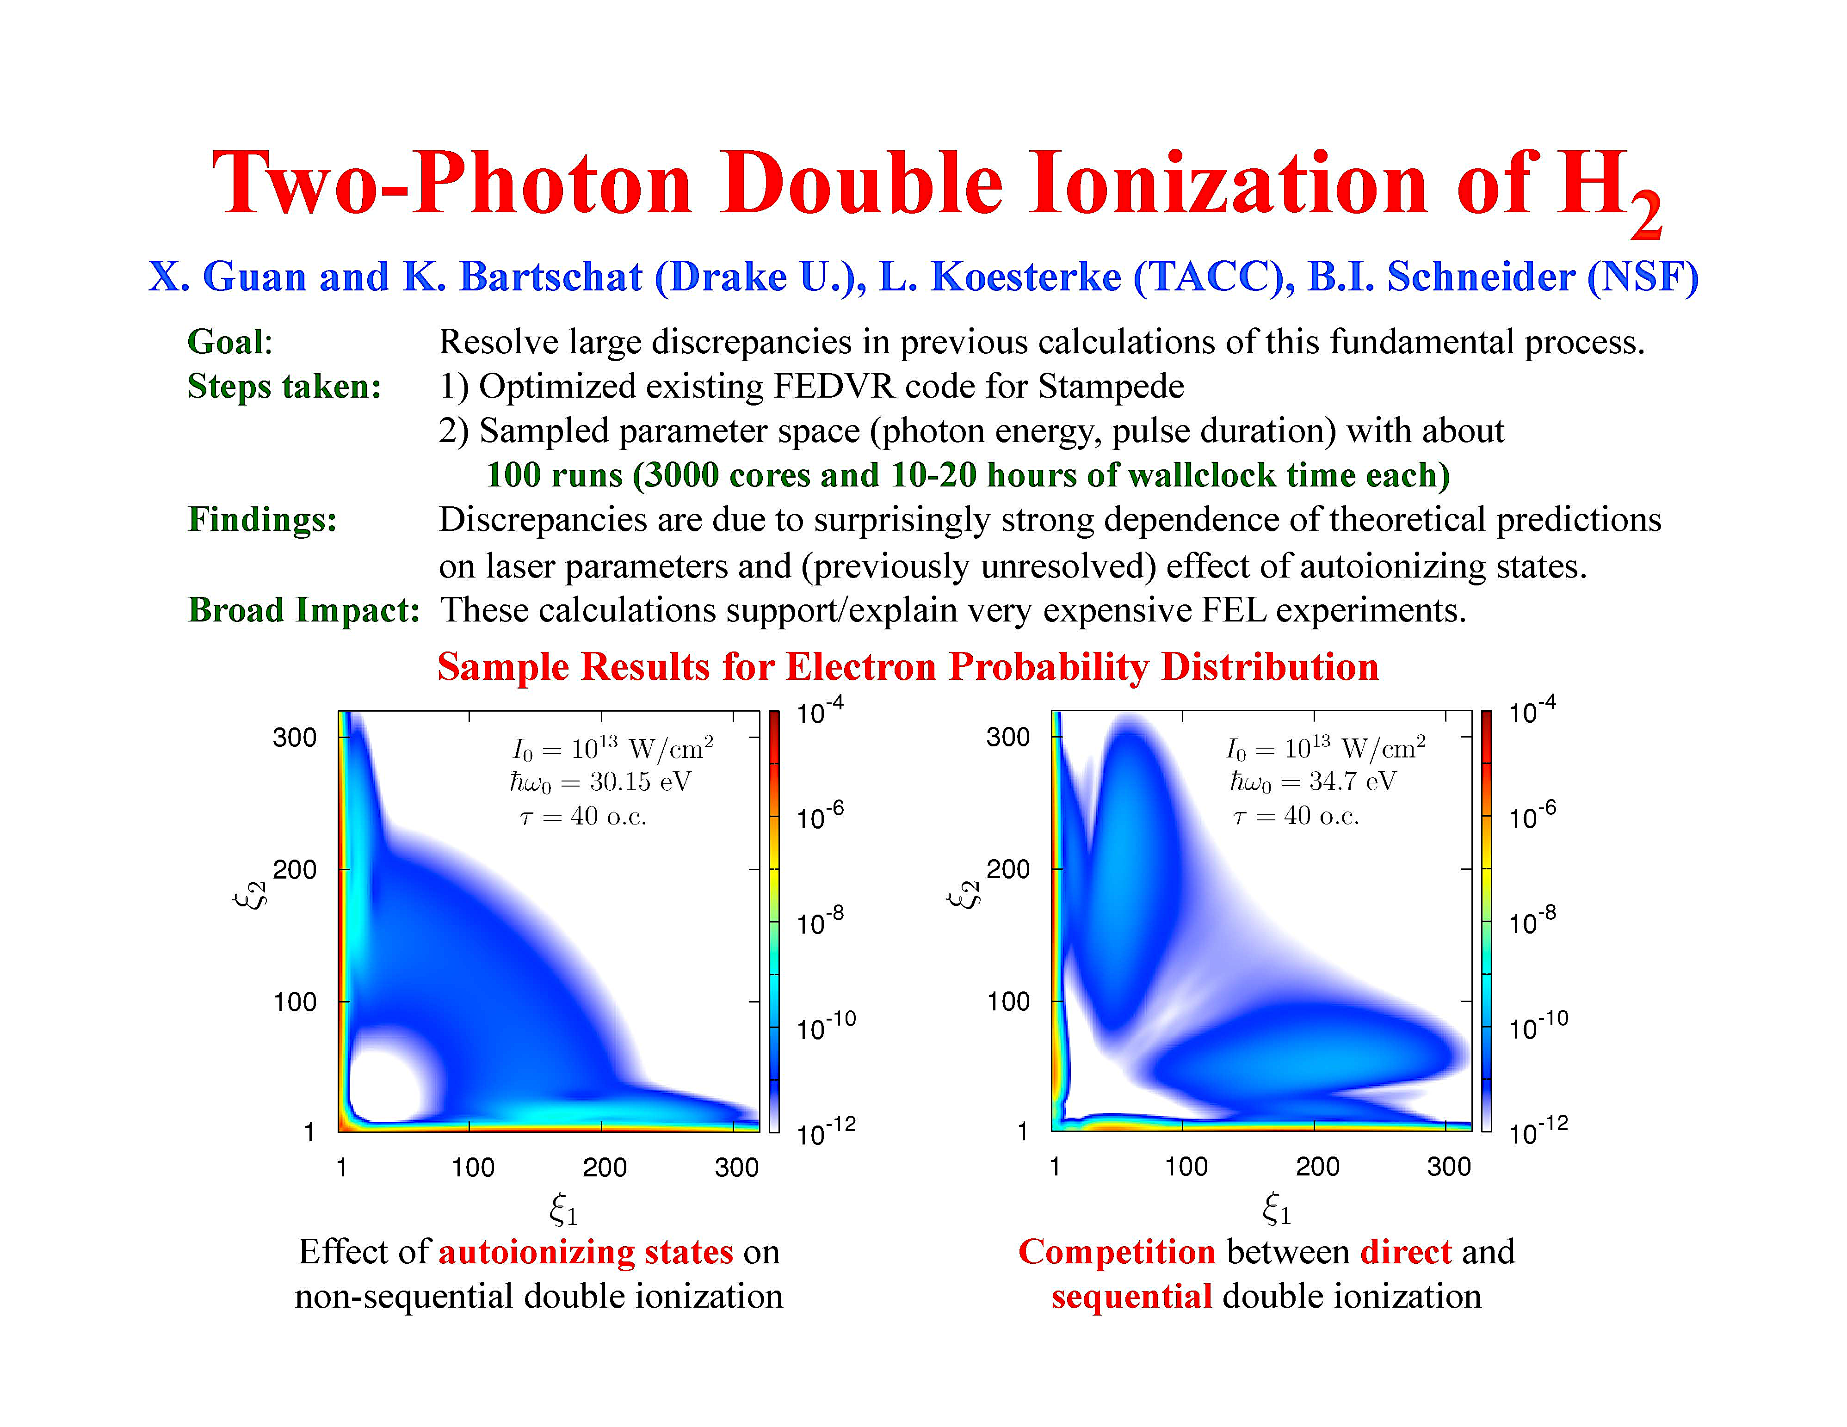
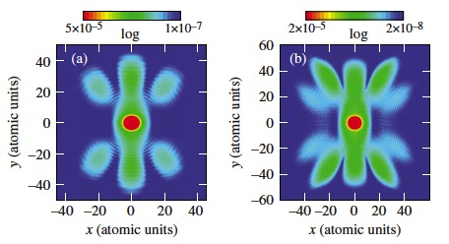
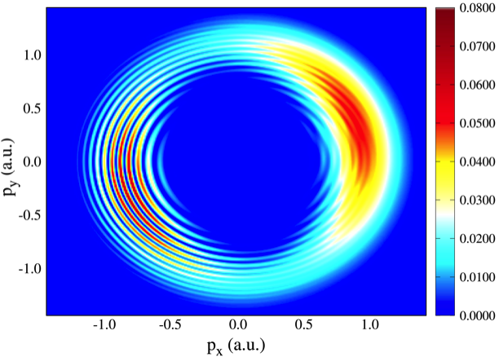
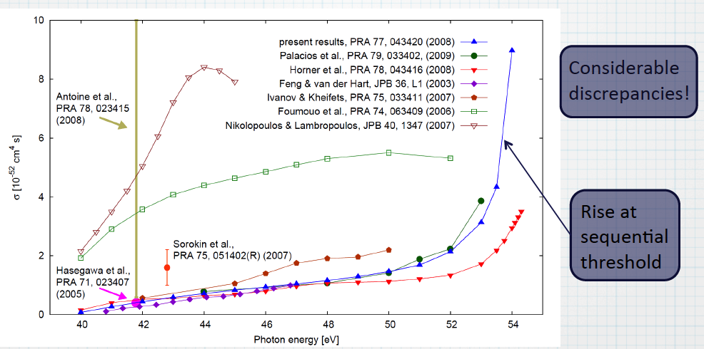
H⁺₂ Ionization in strong, ultrafast
electromagnetic field: Note the
Patterns caused by wave interference from
the nuclei
2-Photon Double Ionization in He: Approaching the Sequential Threshold
Photoelectron Momentum Distribution for Ar
Ionization in Strong Electromagnetic Field
Ionization of Ar(3p) by electron Impact:
Experiment(a) and Theory(b)

